Slide 1
Super Ferry App Screenshots

Slide 2
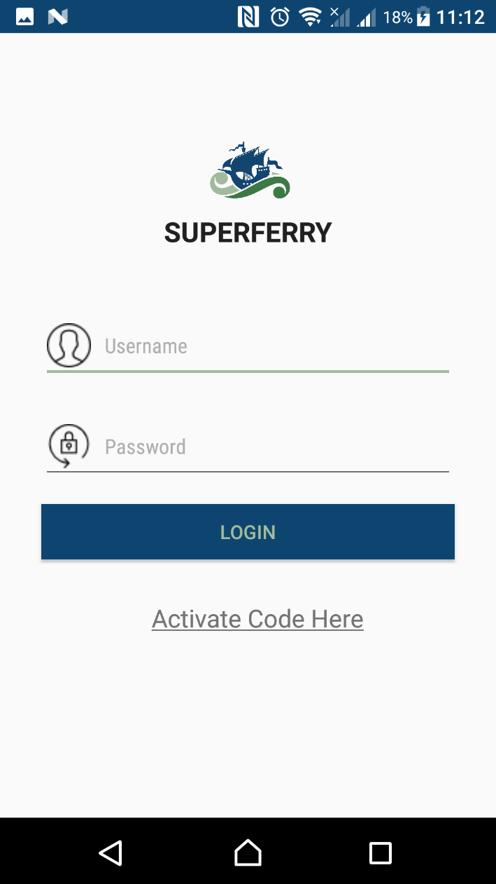
Login form
Login form is where the users can login whenever they want to access the app.
If the user did already create an account for this app they can input their username and password right away and login.
If the user did not have yet an account they can register by clicking the “Activate Code Here”.

Slide 3
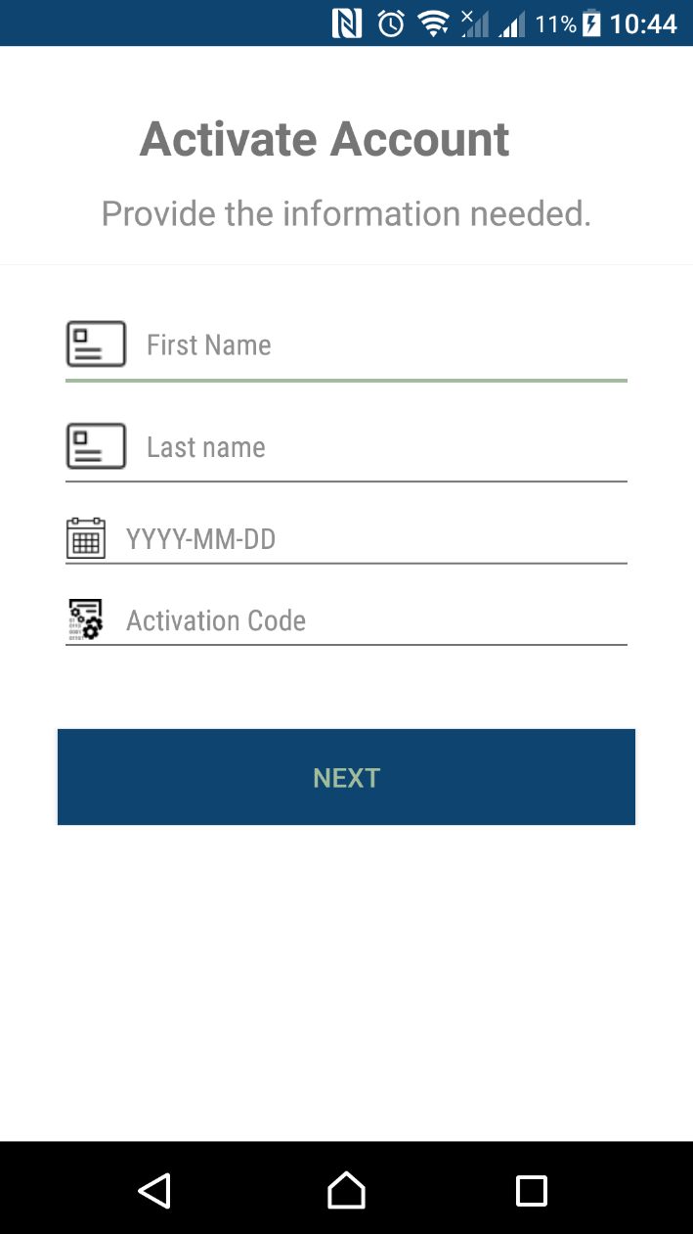
Activation Account
Activation Account is the 1st step to register or activate the account. User must fill all the information needed.
Information contains the following:
First name of the user – the first name of the user must be the same name of what they registered on Passenger Manifest Registration.
Last name of the user – same as the first name it must be the same last name of Passenger Manifest Registration
Date of Birth – must be input the date of birth of the user formatted(YYYY-MM-DD) it must be the same as Passenger Manifest Registration as well.
Activation Code – this code can be acquire through to text or e-mail.

Slide 4
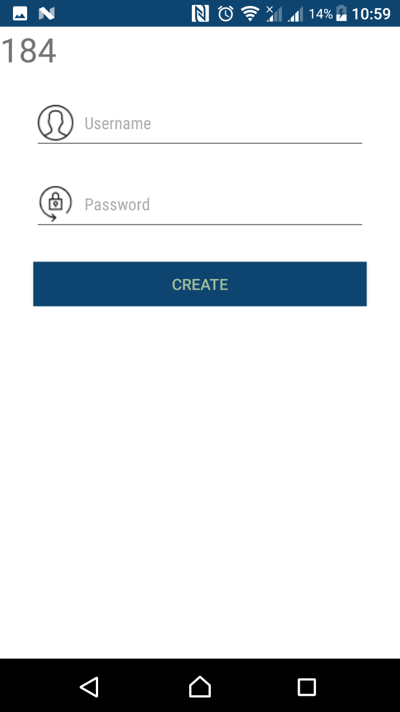
Create Username and Password
This is the 2nd and the last step of creating or activating account.
User can create an unique username and password. It will be use to login in this application.
User only have 200 seconds to complete this session otherwise it will back to the Activation Account Form.

Slide 5
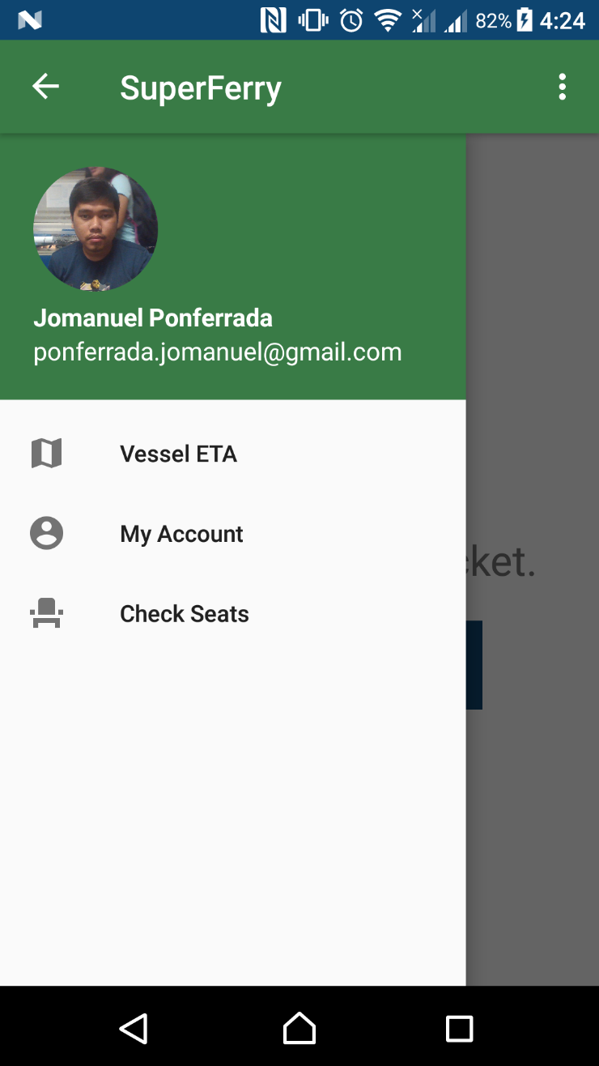
Main Form
This form contains side bar menu where the user can select where they want or what they want in this application.
This form contains the following:
Vessel ETA – this is to view or monitor the vessel trip information.
My Account – to view the Account information.
Check Seat – to view the seat available.
User account information will also be view in the side bar. It’s indicate the picture, name and email address of the user.

Slide 6
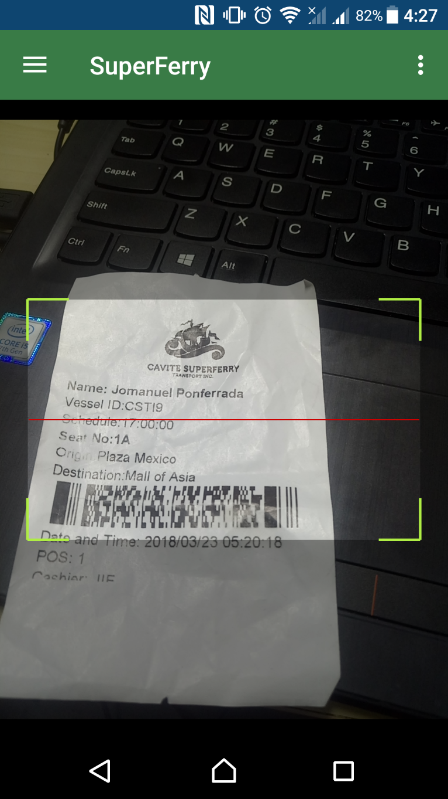
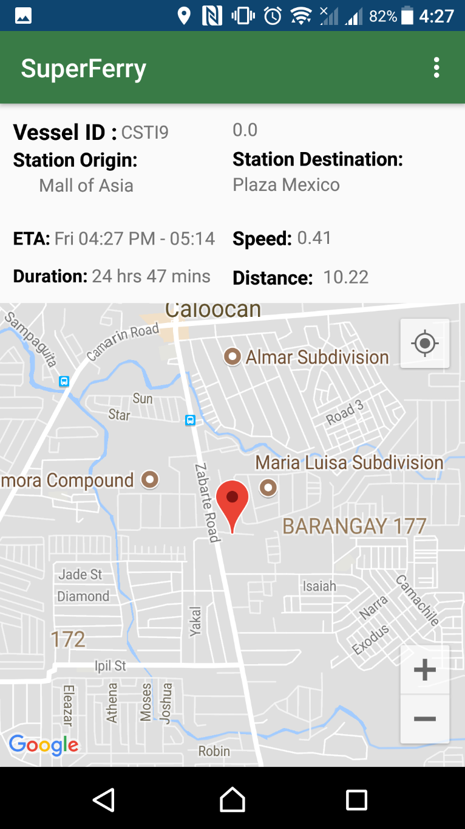
Vessel ETA form
This is to view the trip information of the user.
When the user desires to view their trip information, they must scan the their ticket before they can view their trip.
Once scanning is done, they may now view or monitor the vessel.

Slide 7
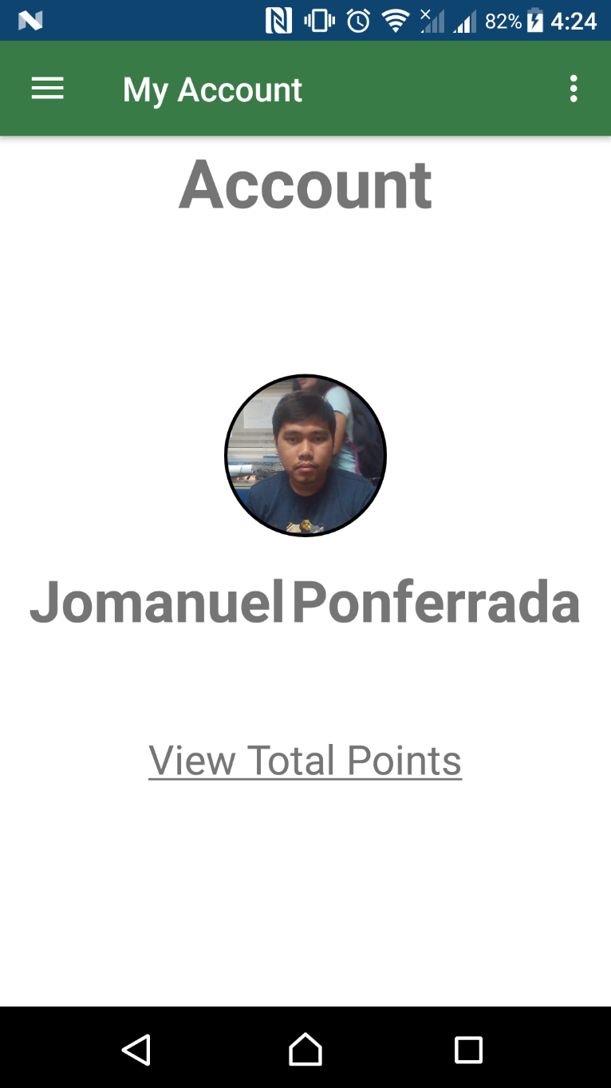
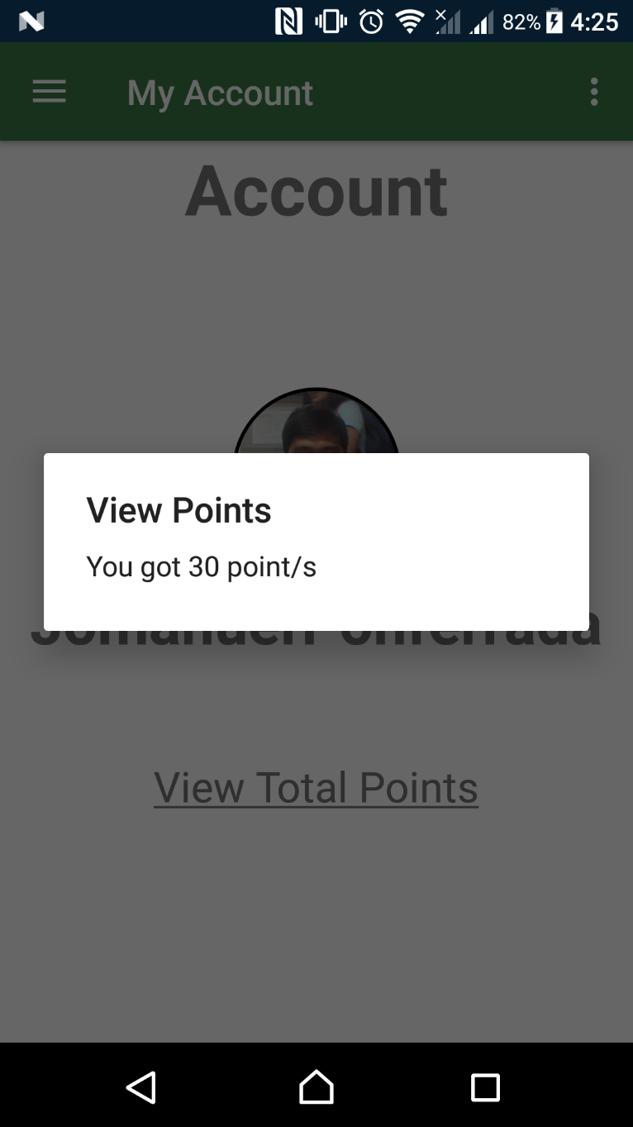
My Account
This form is to view Account information.
They can view their points earned from riding in the super ferry.
It contains picture and name of the user. This details are from server where the user registered for the Passenger Manifest .

Slide 8
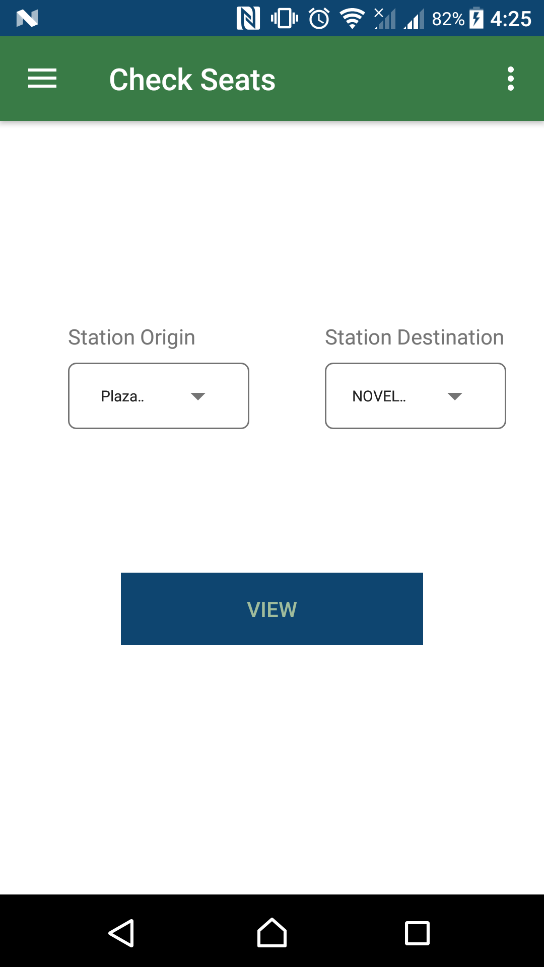
Check Seat
If the user wants to know is how many seat available in the Station Origin and Station Destination that they select.

